Slide 1


GRAMEENPHONE FUTURE MAKERS · AI FOR SOCIAL GOOD
Krishan AI
A Climate Risk Engine, for Bangladesh.
A farm-level climate-risk engine for Bangladesh, turning scattered environmental data into practical farming guidance.
Team OPROTIM
Irfan Sadik Team Leader & AI/ML Engineer
Noor E Jannat Mawa Business Lead
.
Notes:
Good day, judges. We're Irfan and Noor, and this is Krishan AI: climate intelligence, one farm at a time. It's a proposed platform at concept stage, and we'll be clear about what is not yet proven.

Slide 2


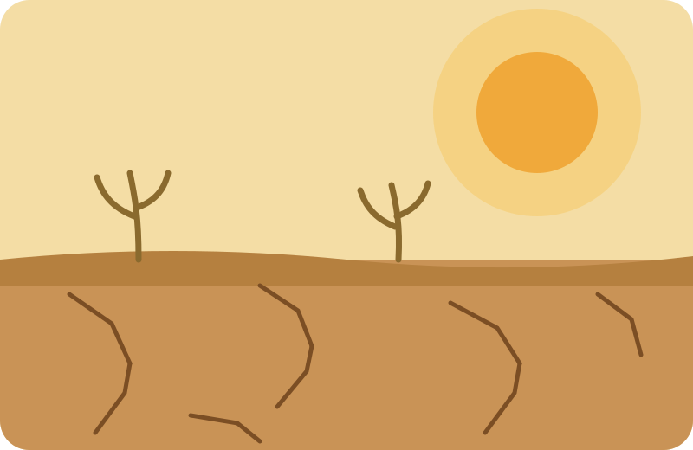
01 · THE PROBLEM
Every farm faces its own climate risk
Risks differ by region, and weather stress on crops can affect farms almost anywhere.
COASTAL AREAS
FLOOD-PRONE AREAS
DROUGHT-PRONE AREAS
Salinity risk
Flooding & waterlogging
Drought & water stress
Rising soil and water salinity can stress crops.
Excess water can damage crops and disrupt field work.
Water shortage can hit crops at critical growth stages.
A regional forecast is not a decision for one farm. Farmers need to know what it means for their own field and crop.
Krishan AI
2
Notes:
Farmers in Bangladesh face different risks: salinity on the coast, flooding in low-lying areas, drought elsewhere. Forecasts exist and help, but a regional forecast can't tell a farmer what it means for their own field and crop.

Slide 3





02 · OUR PROPOSED SOLUTION
From scattered data to a clear next step
1
2
3
4
Environmental data
Farm Context Model
Risk assessment
Practical guidance
Weather, soil, water and satellite information, where accessible
Location, crop, growth stage and history for one farm
Estimated only where reliable prediction is feasible
Expert-reviewed advice in plain Bengali
“What should I do next?”
The farmer's real question. Krishan AI is designed to answer it with evidence, honesty about uncertainty, and a practical action.
PROPOSED SCOPE
Flooding & waterlogging
Salinity
Drought & water stress
Weather–crop risk
More, as data permits
Krishan AI
3
Notes:
Krishan AI would combine environmental data with the context of one farm, estimate risk where prediction is reliable, and turn it into guidance a farmer can act on. It's broader than salinity. The question is simple: what should I do next?

Slide 4



03 · HOW AI FITS IN
From data to decision, in three steps
PROPOSED DATA SOURCES
THE AI LAYER
WHAT THE FARMER SEES
Access still to be confirmed
RISK
1
Find patterns
Satellite imagery
High
Learn from historical and farm-context data
CONFIDENCE
Moderate
Weather & climate data
2
Estimate risk
DATA STATUS
Tested against a simple baseline first
Recent soil reading missing
Soil & water readings
NEXT STEP
3
Support decisions
Request an updated measurement or contact the field officer
Crop & farm records
Turn validated risk into approved guidance
Format example only, not a real prediction
Each risk may need its own target, spatial unit, prediction horizon and model. All are chosen after data assessment, and a model is kept only if it beats a simple baseline.
Krishan AI
4
Notes:
Our data sources are proposed, and access is still to be confirmed. AI would find patterns, estimate risk, and support decisions. Each risk may need its own model, and we'd keep one only if it beats a simple baseline.

Slide 5




04 · RESPONSIBLE AND TRUSTWORTHY AI
It says so when it is not sure
Show the risk with its uncertainty and key factors
Honest uncertainty
YES
Confidence is shown only once it has been tested.
New farm data arrives
Data gaps flagged
Fresh, complete, in range?
Stale, missing or out-of-range inputs are never hidden.
Say “insufficient data”, then request a new reading or refer for expert review
Validated before use
No prediction is presented as fact without evidence.
NO
People stay involved
Expert review is a proposed safeguard; a pathway is not yet established.
Guidance supports, and never replaces, local expertise.
A withheld prediction is better than a wrong one.
Krishan AI
5
Notes:
If data is stale or missing, Krishan AI won't guess. It says insufficient data, asks for a new reading, or refers the case for expert review, a safeguard we propose, not one we've established. It supports local expertise; it never replaces it.

Slide 6





05 · EXPECTED IMPACT AND DIFFERENTIATION
What we hope to achieve, and how we will test it
INTENDED IMPACT
To be tested, not proven
WHAT WE PROPOSE IS DIFFERENT
More informed farm decisions
Farm context
Crop, growth stage and local conditions
Better preparedness for climate risk
Data sufficiency
Says when evidence is too weak
Fewer avoidable climate-related losses
Risk linked to action
Expert-reviewed, versioned guidance
HOW WE WILL MEASURE
Accessible
Performance against a baseline · false alarms and missed events · warning lead time · farmer comprehension and usefulness
Bengali-first, with non-smartphone routes
A provisional pilot of about 100 farms would test workflow feasibility and early performance. It cannot prove national impact.
Existing advisories and forecasts are a foundation. Benchmarking against them is still to be done; we do not claim to be first or only.
Krishan AI
6
Notes:
We hope for more informed decisions, better preparedness and fewer avoidable losses, but these are hypotheses to test. We'd measure performance against a baseline, false alarms, and farmer usefulness, and benchmark against existing services.

Slide 7

06 · EXECUTION ROADMAP
Staged, evidence-gated research and development
MONTHS 0–6
MONTHS 6–12
YEARS 1–2
YEARS 2–3
Discover
Build & test
Validate & cover
Expand carefully
Interview farmers and practitioners
Inventory data and assess quality
Choose a first region, crop, hazard and target
Set baselines and compare suitable methods
Prototype and test in different areas of the selected region
Controlled pilot, about 100 farms (provisional)
Extend across all areas of the selected region, if results hold
Expand to new regions where validation, feasibility and safety criteria are met
Begin separate research on chemical adulteration, once experts and data are available
Every stage ends with a decision: proceed, narrow the scope, or pause. Timelines are planning assumptions, not promises.
Krishan AI
7
Notes:
Our roadmap is staged. In the first six months we listen to farmers, inventory data, and choose one feasible use case. Next we test in different areas of the selected region. In years one and two we run a controlled pilot and, if results hold, cover all areas of that region. Only in years two to three would we expand to new regions and begin separate research on chemical adulteration. Every stage can proceed, narrow, or pause.

Slide 8

OUR VISION
Not more data.
A clearer next step.
Farm-level climate intelligence that helps farmers make more informed decisions: built on evidence, honest about uncertainty.
Krishan AI
Irfan Sadik, Team Leader & AI/ML Engineer
Noor E Jannat Mawa, Business Lead
Grameenphone Future Makers · AI for Social Good · Concept and prototype-stage proposal
Notes:
Not more data, but a clearer next step. Our aim is farm-level climate intelligence, built on evidence and honest about uncertainty. Thank you.

